Slide 1


Dukes Sustainability Journey 24/25
Autumn term update

Slide 2

Carbon net zero journey update oct24
Operations – efficiency and reduction
Embedding sustainability into the curriculum
Sustainable working culture
Notes:
History
Global action
UN SDGS
Goodlife gaols

Slide 3
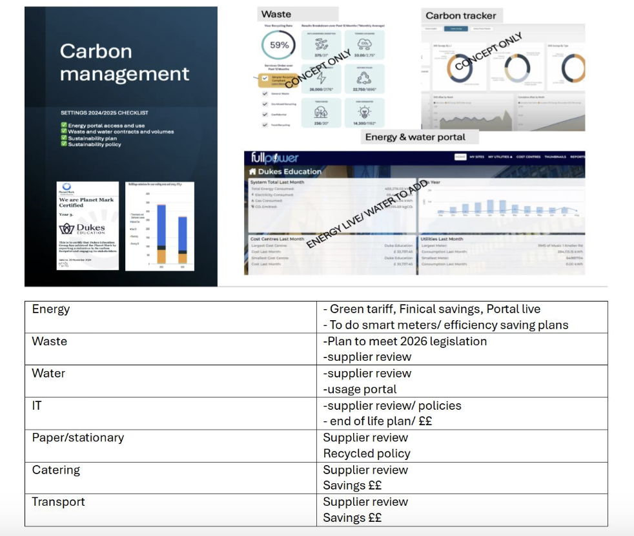
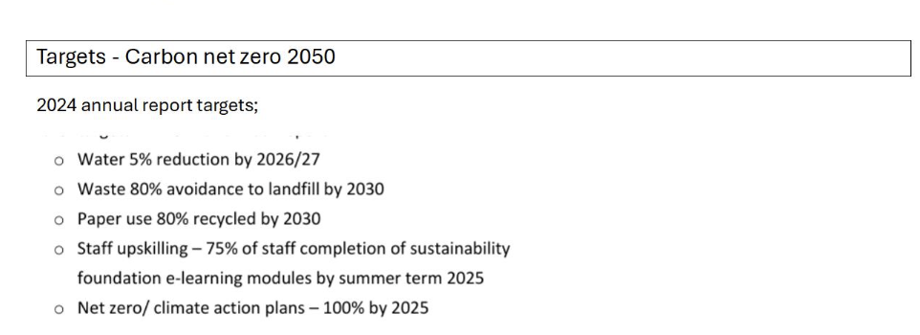
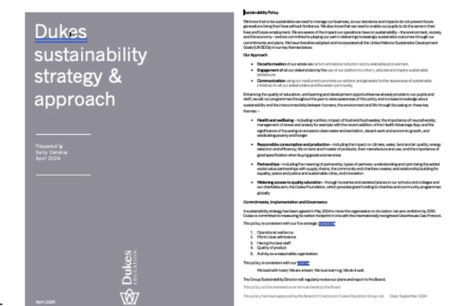

Slide 4
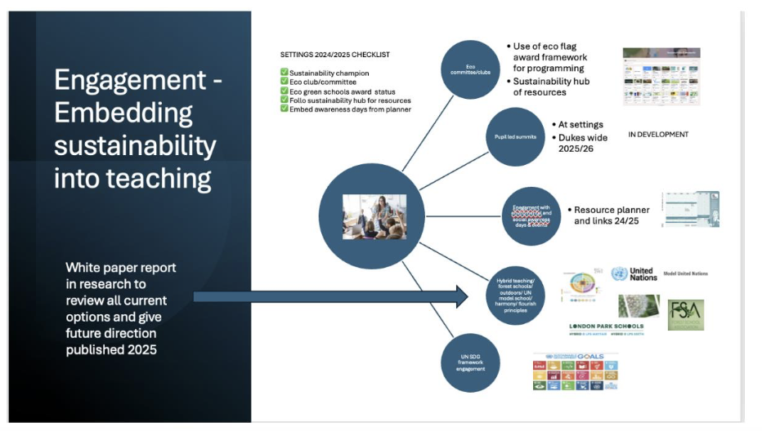

Slide 5
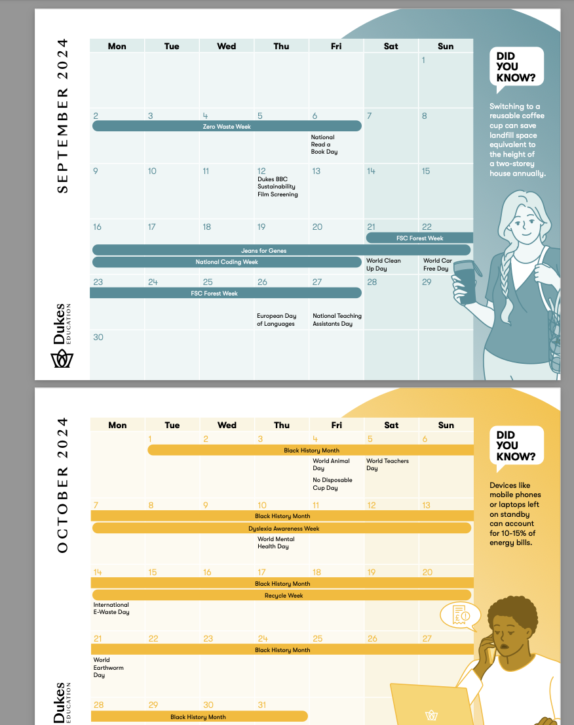
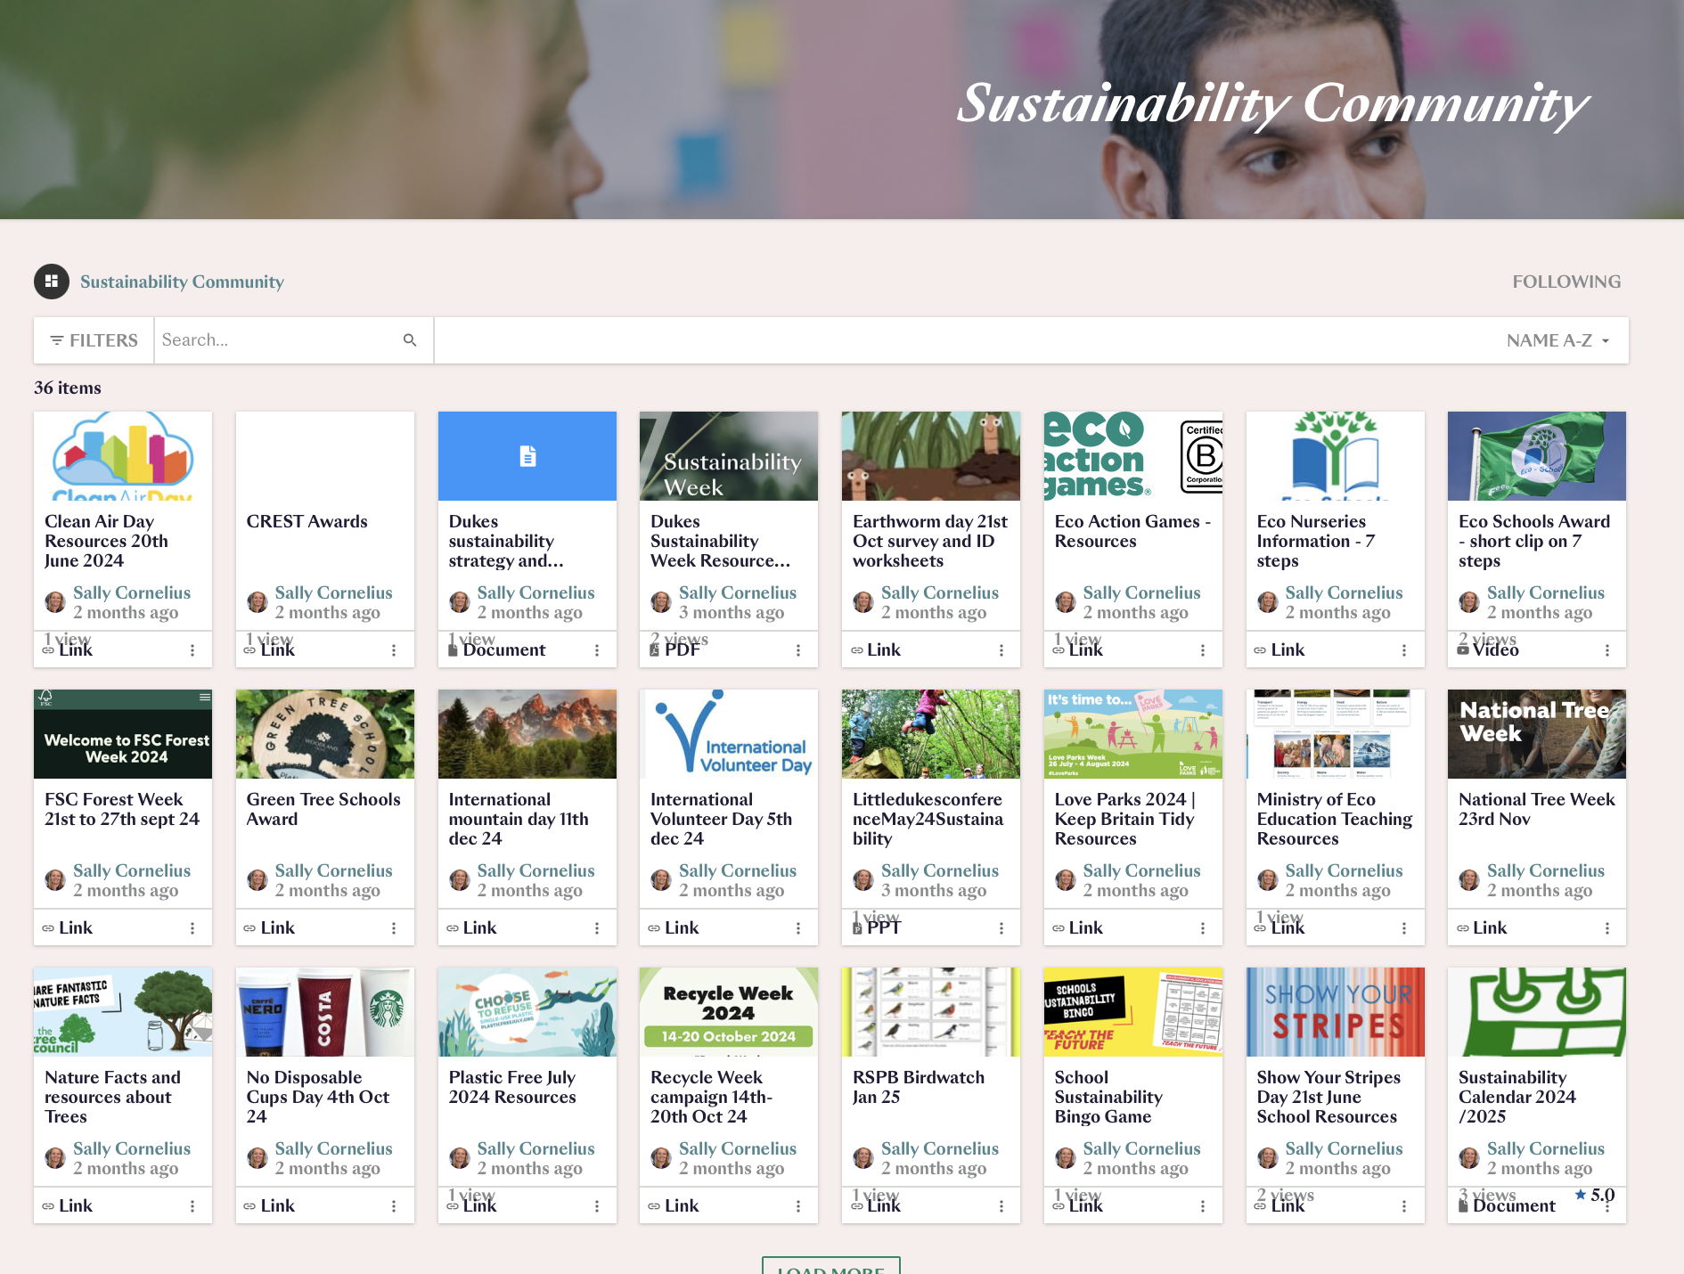
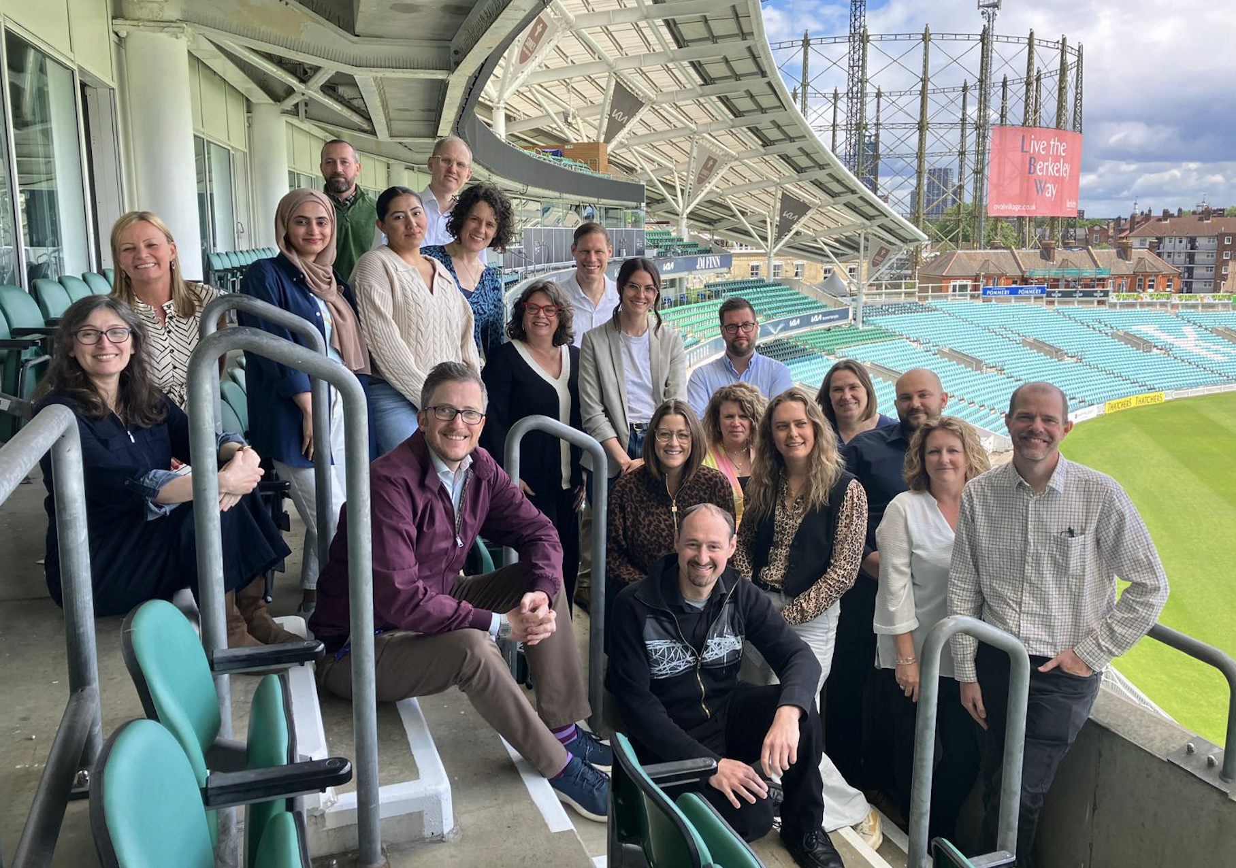
Support and resources
Notes:
Champions network
Calender
hub

Slide 6
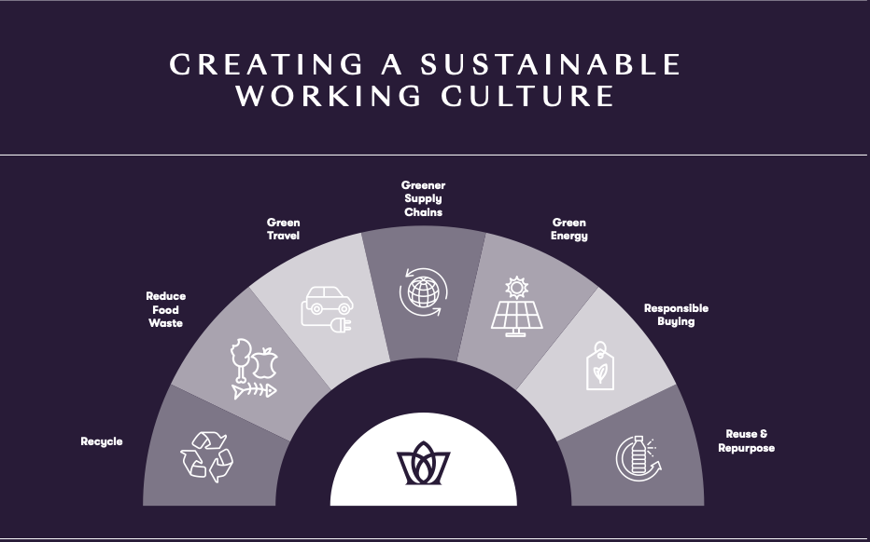
An individual taking steps is progress.
But a community taking steps together leads to real change.
Notes:
culture

Slide 7
https://vimeo.com/shootthecompany/review/1014853973/6c66a143ec
An individual taking steps is progress.
But a community takin steps together leads to real change.
Notes:
culture

Slide 8
Checklist 2024/2025
Sustainability champion
Eco club/committee – use of eco schools framework
Sustainability SLT item
Sustainability policy and plan
Follow sustainability hub for resources
Embed awareness days from the planner
Staff to complete sustainability e-learning modules
Webpage and post per half term
Energy portal access and use
Other supply chains review and management

