Slide 1
Partnership Opportunities
WAYNE MARSHALL - PRINCIPAL

Slide 2
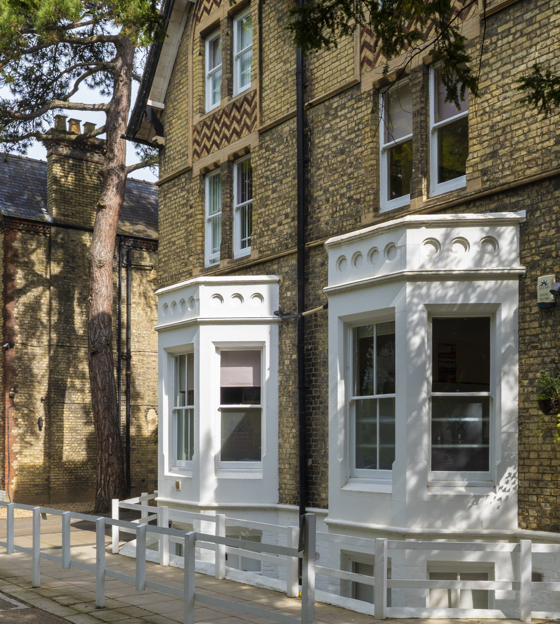
The College was established in 1976 – the oldest tutorial college in Cambridge
We limit the number of students in the College to 200
Located in the heart of Cambridge
78% of our Foundation course students progessed to a UK top 20 University

Slide 3
The foundation program has been running since 1996.
It offers Humanities, Science and Art based courses running from September to June and January to June each year.
Students are able to progress to top universities (except G5 from the course).
The course runs at the same Regulated Qualifications Framework (RQF) level as A levels and is therefore the steppingstone to Universities in the same way that A levels are.
The course has the same number of hours for the September start as it does for the January start.

Slide 4
THE COLLEGE WILL PROVIDE:
The course specifications
Assistance with recruitment where applicable
Work with the teachers with CPD and advice
Visit the college in November/ December and Jaune/ July each year
Provide the exams scrips and mark the scripts and then pass over the results with leaning CPD for the teachers
Help with UCAS and university placement in the UK and beyond
A full list of policies and procedures for the course and its offerings
Teacher guidance via Zoom, email and visits

Slide 5
IELTS:
The college will provide the following support learning:
A course specification
A handbook to assist with understanding and learning
A list of texts to be used for each level of IELTS being taught

Slide 6
THE COLLEGE WILL PROVIDE:
A report after each exam session for the teachers and students to take on board in preparation for the following series
Student recruitment guidance
A formal review at the end of each academic year
Assistance with university placement
of students

Slide 7
IN COUNTRY SUPPORT: (Agim Neziri – Intereducation Ltd)
Will provide guidance and support for recruitment of staff, marketing of students and a link with St Andrews
They will through their key staff offer academic guidance for the foundation courses and UCAS applications
They will support our partners with insight and understanding of the UK education system

Slide 8
THE COSTS
A one-off franchise fee of £20,000
An annual admin fee of £5,000
Student fee of £750 per student per course (annual review) for examinations and logistics

Slide 9
AN EXAMPLE
Year 1
Based on 15 students
You would pay £36,250
Your revenue would be approx. £60,000 (£4,000 per student per year)
Your gross profit before costs would be £23,759

Slide 10
AN EXAMPLE
Year 2
Based on 30 students
You would pay £27,500
Your revenue would be approx. £120,000 (£4,000 per student per year)
Your gross profit before costs would be £92,500

Slide 11
AN EXAMPLE
Year 2
Based on 45 students
You would pay £38,750
Your revenue would be approx. £180,000 (£4,000 per student per year)
Your gross profit before costs would be £141,250

Slide 12
THE ADVANTAGES
It gives your students a UK foundation education without leaving Albania
The costs are not restrictive based on UK prices (approx. £42,000)
It enables students to progress to top UK universities
Parents can use the cost of the foundation education in Albania to supplement UK university education

Slide 13
THE PARTNERSHIP
We currently have a partner in Abuja who are in their 7th year of operations. They have 115 students this year, this has grown from 15 students in their first year
We are looking for partners in the Albania and surrounding countries to grow and enhance the brand
We do not want to flood the market with the offering, but we need to seek partners who show the same integrity, ambition and student care as we do.

Slide 14
UNIVERSITY DESTINATIONS
University of Leeds UK
University of Birmingham UK
Aston University UK
University of Sussex UK
University of Bradford UK
University of Sheffield UK
Coventry University UK
University of Calgary Canada
Nottingham Trent University UK
University of Leicester UK
University of Nottingham UK
University of Surrey UK
University of Brighton UK
Swansea University UK
Massachusetts College of Pharmacy and Health Sciences US
Rajeeu Gandhi Flying School New Delhi India
Nigeria College of Aviation Technology Zaria Nigeria
Leeds Beckett University UK
University of East Anglia UK
University of Kent UK
University of Reading UK
University of Huddersfield

Slide 15
UNIVERSITY DESTINATIONS
Birmingham City University UK
University of Salford UK
Loughborough of University UK
Bournemouth University UK
University of Portsmouth UK
University of the West of England UK
De Montfort University UK
University of Middlesex Dubai
University of Liverpool UK
University of Leeds UK
University of Surrey UK
Herriot Watt University Dubai
UK College of Business Dubai
Cardiff Metropolitan University UK
Nile University Nigeria
University of Strathclyde UK
University of South Carolina US
Newcastle University UK
University of Birmingham UK
University of Dundee UK
University of Debrecen Hungary
University of Algoma Canada

Slide 16
UNIVERSITY DESTINATIONS
Brunel University London UK
Buckinghamshire New University UK
University of Reading UK, Royal Holloway
University of London UK
University of Surrey UK
University of Hull UK
University of Greenwich UK
University of Central Missouri UK
University of Bedfordshire UK
University of Essex UK
University of Gloucestershire UK
University of Glasgow UK
University of Kent UK
University of Southampton UK
Keele University UK
University of Sunderland UK
St. George's University Grenada
Teesside University
National College of Ireland
Kingston University UK,
London South Bank University UK

